Slide 1
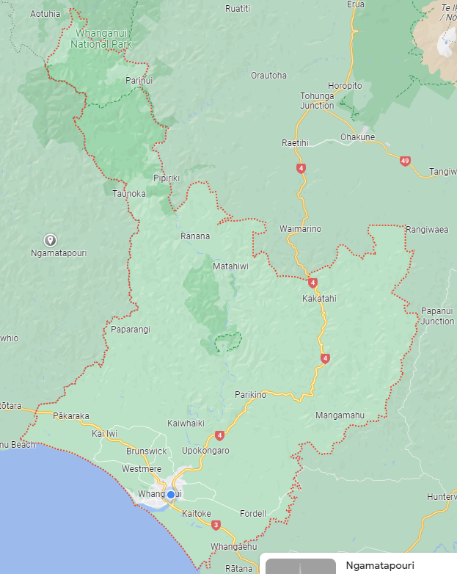
Māori Wards est 2025?

Slide 2
Why are we here? Representation Review
The Local Government Electoral Act 2001, section 19H states council must determine by resolution:
If elections will be:
as a whole district
two or more wards
or as a district as a whole and by one or more wards
The number of members to be elected
The name and boundaries of each ward and number of members for election, if applicable
If a local board will be confirmed, the number of members, any boundaries, the name of the board and number of members per ward
To review these arrangements at least once very 6 years
Notes:
Representation review will include – at large or wards, name of wards if applicable, number of elected members, community boards, maori wards, other representation options – by 1 March 2024.
A decison on Māori wards is needed before the represenation review decisions are made

Slide 3
Why are we here? Māori Wards
The Local Government Electoral Act 2001, 19Z states council may resolve to establish Māori wards.
Council may resolve to create one or more wards for electoral purposes
Decision must be made by 23 November, 2 years before the next triennial election.
The number of Māori members is decided by a set formula

Slide 4
What effect will Māori wards have if introduced?
They are similar to parliamentary wards
Nomination to stand for Māori ward seat is by two enrolled voters
Two of the twelve seats will be filled by votes from the Māori electoral roll
Māori councillors are not treaty partners and have the same obligations to serve the community as non Māori councillors. Councils still need to consult with mana whenua, iwi and other māori organisations

Slide 5
Engagement
Survey opened 5 August – 8 September
Met with Tamaupoko, Tupoho, Ngaa Rauru and Ngati Apa
Emailed marae, hapū, and key Māori organisations
Community korero – 7 September
Community kai – 7 September
Hui at two marae
Presentation at iwi hui
Email to Māori networks
Media release and facebook post
Notes:
20 hapū
13 marae
2 iwi

Slide 6
The Survey
Do you support the introduction of Māori wards in Whanganui District Council?
511 responses
43% Māori
57% NZ European
47% No
53% Yes
2 iwi support
3 hapū support
Notes:
Māori
205 identified themselves as Maori of which 167 voted in favour, 37 against, 1 didn’t vote but comments suggest in favour
50 enrolled on general roll
150 enrolled on Māori roll., 5 plan to enrol
34% 60 years and over
25% 40-49 years
European
205 identified themselves as NZ European of which 70 were in favour, 135 against
Iwi – Ngati Apa and Nga Rauru
Hapū – Ngati Hinekorako, Ngati Ruaka, Ngati Patutokotoko

Slide 7
Themes from comments received
Will cause separatism, one community
No increase in the cost for ratepayers
One person, one vote, racist idea to appease the minority
Does not absolve council from having working relationships with hapū, iwi and Māori
Equity and partnership
Acknowledges and honours He Whakaputanga and Te Tiriti o Waitangi
Guarantees a Māori voice and lens at the decision making table
A step toward true co-governance

Slide 8
What are the options?
Resolve to establish Māori wards for 2025 local election
Resolve not to establish Māori wards
Notes:
Establish – Decision is final, no provision for a poll. Poll option repealed in 2021
Representation review will enable submission on the council’s represntation proposal. Councill is not able to reverse its decision on Māori wards. Subimssions may include the name of a māori ward, statistical entitlement to increase number of maori seats/wards, if more than one maori ward, boundaries of those wards.
Not establish – no change

Slide 9
Next steps
A decison report on Māori wards to Council on 24 October 2023
A report on the Representation Review Calendar and request for the establishment of a Representation Review working group on 24 October 2023

Slide 10
More information – handy links
Local Government Commission – Guidelines for local authorities undertaking representation reviews
Local Electoral Act 2001 –
Part 1A Representation arrangements for elections
Notes:
Repealed sections 19ZA – 19ZG come into effect after the 2025 election

